Slide 1
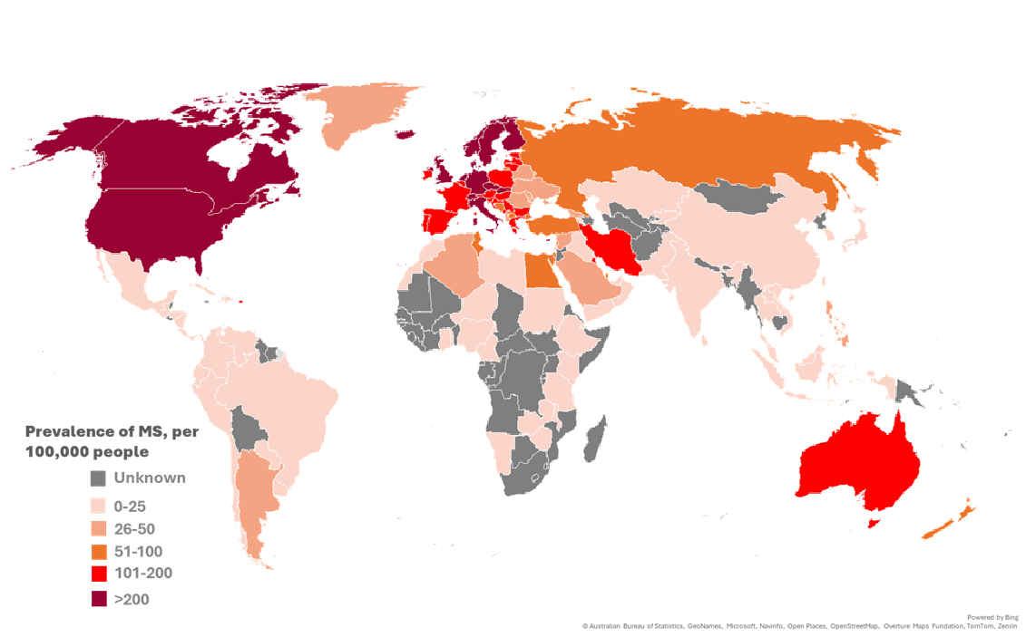
Atlas of MS estimates that 3.1 million people are living with MS worldwide (38.1 per 100,000) population)
Atlas data collection year 2024
Notes:
Key message
The latest Atlas of MS estimates that 3.1 million people are living with multiple sclerosis worldwide, equivalent to 38.1 people per 100,000 population.
About the map
The map shows the estimated prevalence of MS per 100,000 people by country.
Darker colours indicate higher prevalence.
Grey countries indicate that prevalence data were unknown.
The estimate is based on data from 133 countries representing approximately 93% of the world's population.
Key observations
MS occurs in every region of the world.
Prevalence varies considerably between countries and regions.
The highest prevalence estimates are observed in North America and parts of Northern and Western Europe.
Consistent with previous research, prevalence is generally higher in countries at higher latitudes, although substantial regional variation exists.
Improvements in data availability and epidemiological studies have strengthened understanding of the global distribution of MS.
Interpreting the findings
Prevalence refers to the total number of people living with MS at a given point in time.
Differences between countries may reflect variation in risk factors, access to healthcare, diagnostic practices, survival, data quality and availability of epidemiological studies.
Comparisons between countries should be interpreted within the context of differences in data sources and data quality.
About the Atlas
Atlas data were collected primarily during 2024 through collaboration with national MS organisations, clinicians, researchers and other country experts.
The Atlas of MS is led by the Multiple Sclerosis International Federation and provides one of the most comprehensive global picture of MS prevalence currently available – for more information email atlas@msif.org

Slide 2


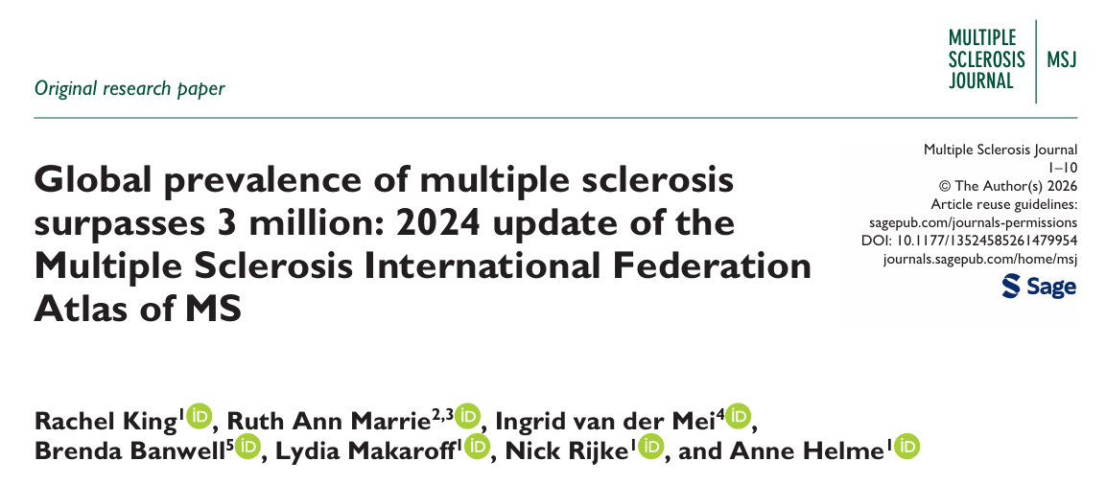

Atlas of MS estimates that 3.1 million people are living with MS worldwide, up from an estimated 2.8 million in 2020 and 1.8 million in 2013.
2024
3.1
million
2020
2.8
million
2013
1.8million
Atlas data collection year
Note: 2013 estimate recalculated using current Atlas methodology
Increasing prevalence likely reflects better diagnosis, people with MS living longer, improved data systems, growing awareness, and population growth. However, the available do not tell us whether the risk of MS is increasing.
https://doi.org/10.1177/13524585261479954
Notes:
Key message
The Atlas of MS estimates that 3.1 million people are living with MS worldwide, up from an estimated 2.8 million in the 2020 and 1.8 million in the 2013.
Understanding the trend
The bars represent global prevalence estimates based on data collected for successive Atlas updates.
The latest estimate is based on data collected primarily during 2024.
The 2013 estimate was recalculated using the current Atlas methodology to improve comparability across time.
The increase over time reflects a combination of factors rather than a single cause.
Interpreting the increase
Increasing prevalence reflects better diagnosis, people with MS living longer, improved data systems, growing awareness, and population growth.
The available data do not tell us whether the risk of developing MS is increasing.
An increase in prevalence does not necessarily mean that more people are developing MS.
About the Atlas
The Atlas of MS is led by the Multiple Sclerosis International Federation and brings together data provided by MS organisations, clinicians, researchers and other country experts worldwide.
The accompanying manuscript provides further detail on the methods used to generate the global prevalence estimates.
Visit the atlas website Number of people with MS | Atlas of MS to access the manuscript, epidemiology report, infographic and other tools.

Slide 3


DOI: 10.1177/13524585261479954
Notes:
Key message
The global estimate of 3.1 million people living with MS worldwide is published in a peer-reviewed scientific journal.
The manuscript provides the scientific basis and methodology underpinning the latest Atlas of MS prevalence estimates.
About the publication
The paper, Global prevalence of multiple sclerosis surpasses 3 million: 2024 update of the Multiple Sclerosis International Federation Atlas of MS, was published in the Multiple Sclerosis Journal.
The publication describes the data sources, analytical methods, findings and limitations used to generate the global prevalence estimates.
The study is based on data from 133 countries representing approximately 93% of the world's population.
Using this slide
Scan the QR code or use the DOI link to access the full publication.
Presenters may wish to use this slide when referencing the scientific evidence behind Atlas findings.
Further Atlas materials, including the lay friendly epidemiology report, infographic, country factsheets and interactive data visualisations, are available at www.atlasofms.org.

Slide 4
Around the world there are
3.1m
PEOPLE WITH MS
Notes:
The latest Atlas of MS estimates that 3.1 million people are living with MS worldwide.
This is the highest global estimate reported by the Atlas of MS to date based on data collected in 2024 and published in 2026
For more information please see www.atlasofms.org

Slide 5


For more information about the Atlas of MS, please contact:
Rachel King,
MS International Federation (MSIF)
atlas@msif.org

